Slide 1
Brief introduction of DL with Pytorch

Slide 2
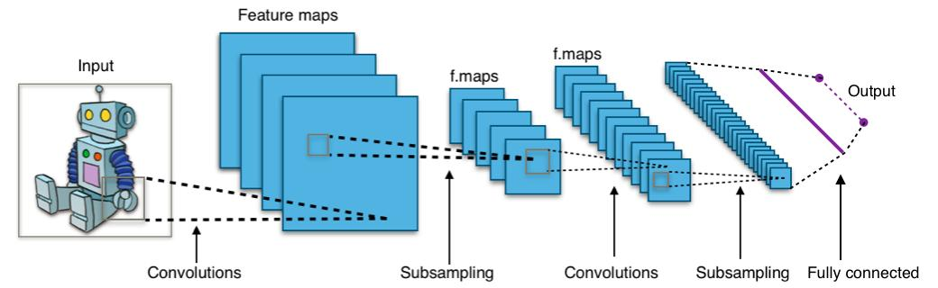
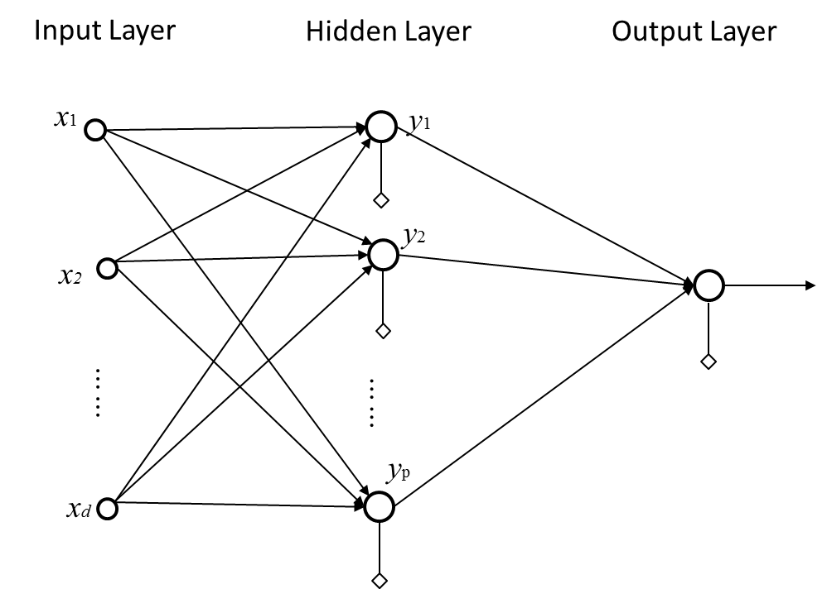
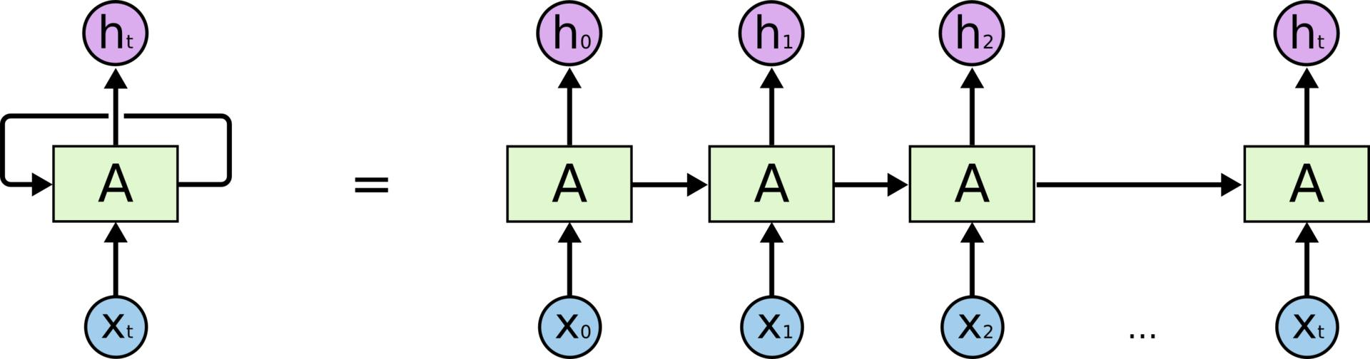
Deep Learning?
Deep Learning architecture: MLP, CNN, RNN, etc.
(2) CNN
(1) MLP
(3) RNN

Slide 3
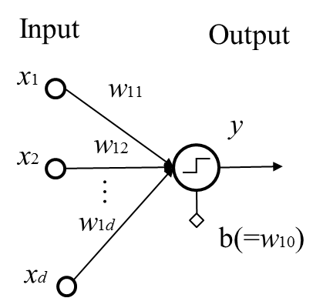
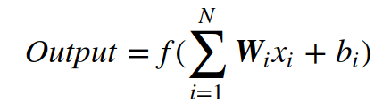
MLP model (Multilayer perceptron)
feed-forward neural network
composed of perceptrons
Perceptron unit: weight, bias, (activation function)
(2) Perceptron
(1) MLP

Slide 4
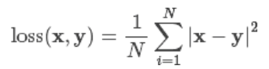
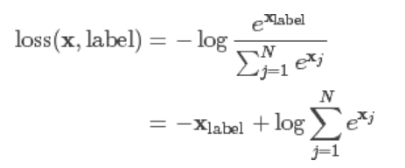
How does MLP model works?
The choice of loss function is depend on what the problem you want to solve.
Regression?
Classification ?
→ MSE (Mean Square Error)
→ CrossEntropy
→ L1, L2, SmoothL1, etc.
(1) MSE
(2) Cross Entropy

Slide 5
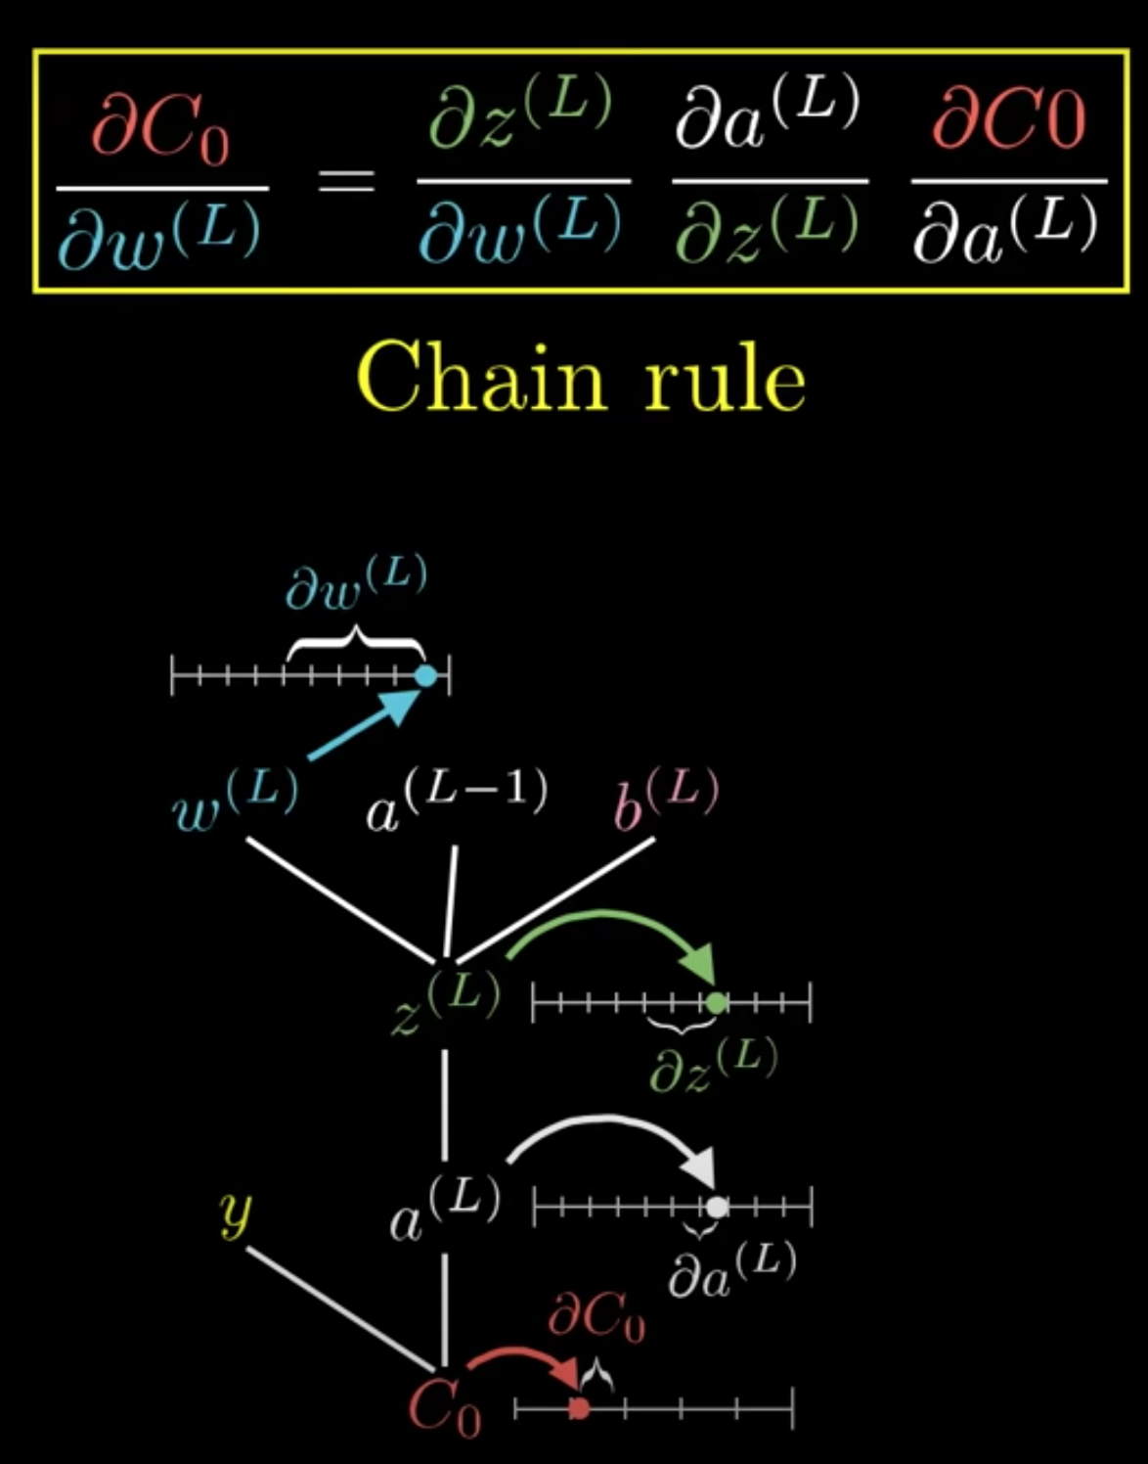
How does MLP model works?
Backward propagation -- training process
https://www.youtube.com/watch?v=tIeHLnjs5U8&t=456s

Slide 6
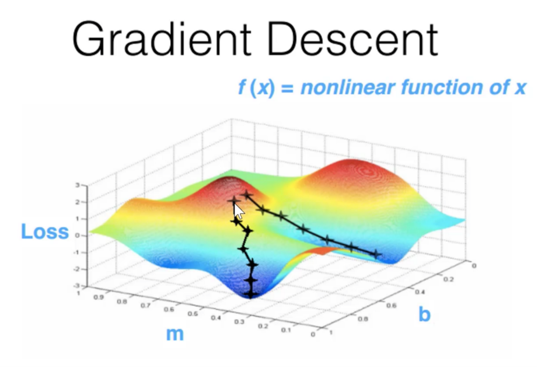
How does MLP model works?
Optimizer
SGD
SGD with momentum
Adam
AdaGrad
RMS Prop
…….
Stochastic Gradient Decent
get mini batch
feed forward
calculate loss
calculate gradients
apply gradients with learning rate
repeat

Slide 7
Pytorch introduction

Slide 8
Pytorch
A deep learning research platform that provides maximum flexibility and speed
Ndarray library with GPU support
np.ndarray → torch.Tensor
Automatic differentiation engine
→ Variable (to create computational graph) → Tensors and Variables have merged
Gradient based optimazation package & data loader API
→ torch.optim, torchvision, torch.utils

Slide 9
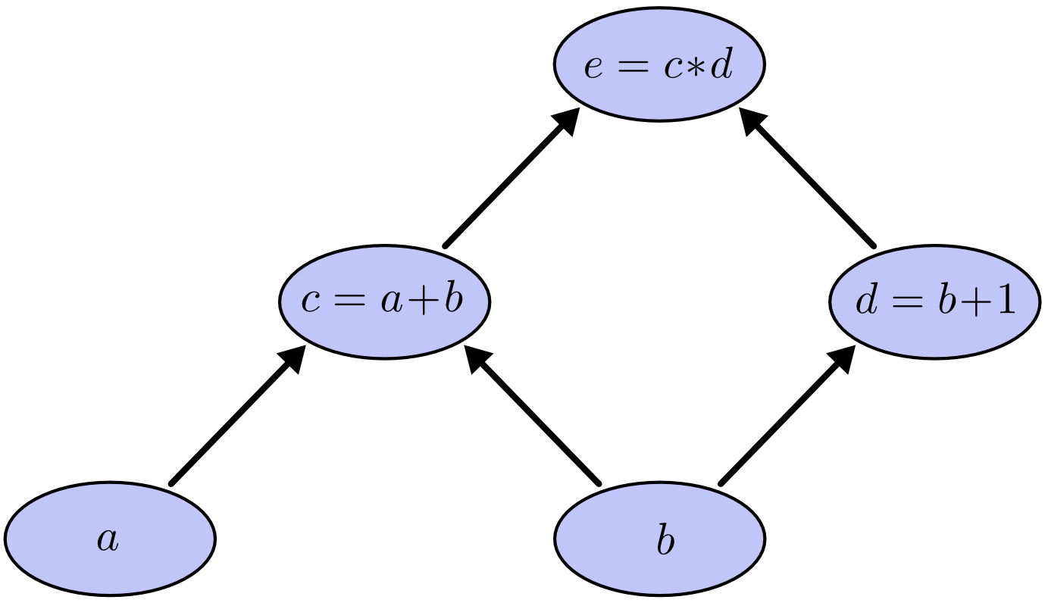
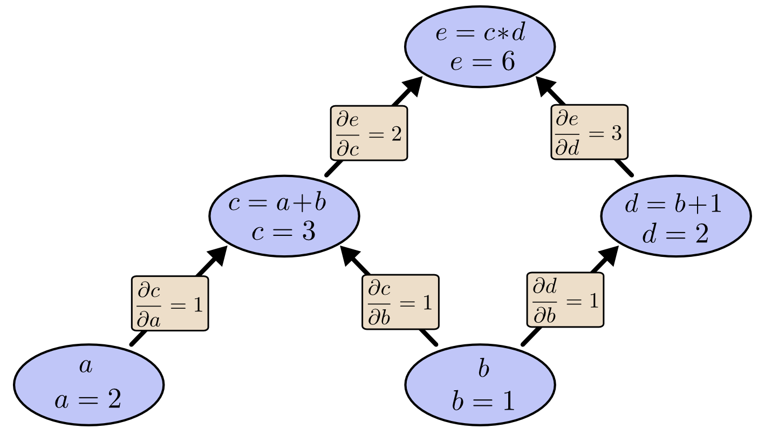
Tensor
All computable data are shaped into Tensor in pytorch
Support GPU
Autograd features
Implement Computation graph automatically
→ See example 1,2
Computation graph 1
Computation graph 2

Slide 10
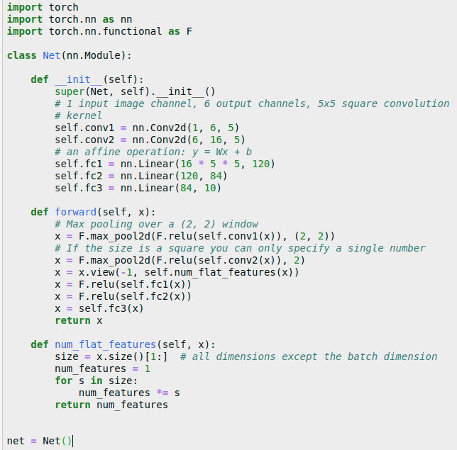
Network Implementaion
Use torch.nn.module
Include:
Network layers [torch.nn link]
Forward data flow definition
(Data Flatten)

Slide 11
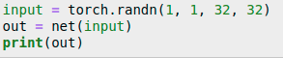
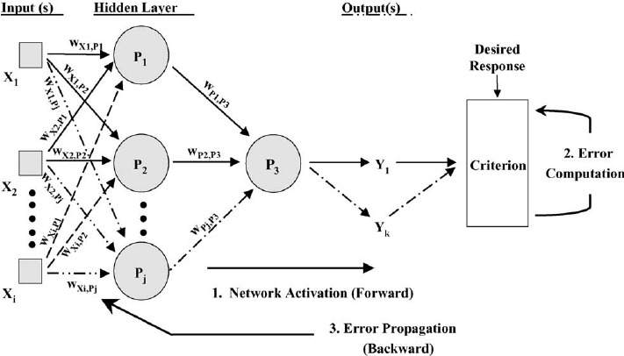
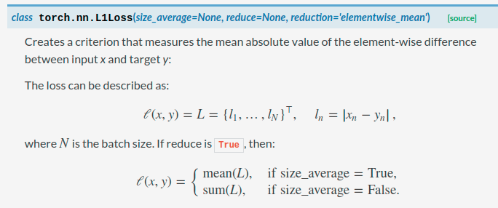
Data flow
Forward
Loss function [torch.nn link]
nn.L1Loss
(1) L1Loss description in pytorch document
(2) Feed-forward neural network

Slide 12
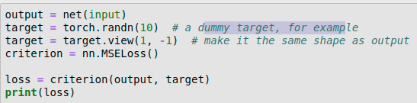
Data flow
Loss function (continue...)
nn.MSELoss
nn.CrossEntropyLoss
....
Backward
→ See example 3
(2) Feed-forward neural network

Slide 13
Linear Regression
→ See example 4

